Slide 1
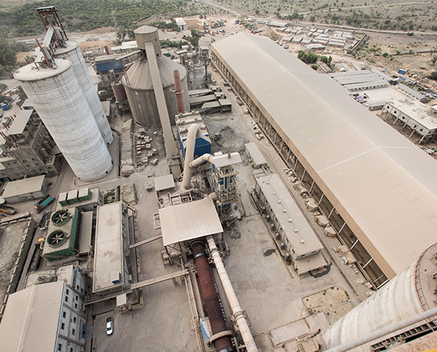
Company Analysis:
Cherat cement company limited
Hamza khan

Slide 2
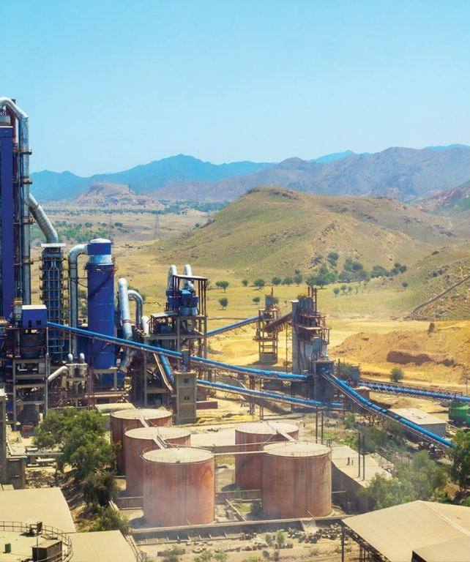
Mission statement
To be regarded by investors as amongst the best blue-chip stocks in the country.
Invest in projects that will optimize the risk-return profile of the Company.

Slide 3
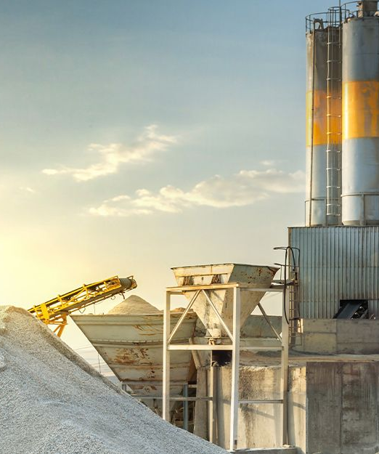
vision
“Growth through the best value creation for the benefit of all stakeholders”

Slide 4
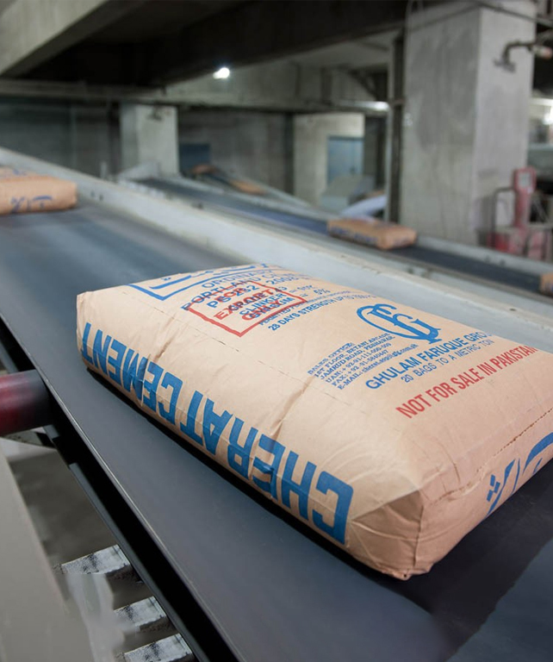
Products Range
. Ordinary Portland cement.

Slide 5
Excerpts from chairman's message
Political instability in country
Effects of Covid 19 pandemic
Decline in sales
The successful commissioning of solar energy at various sites has improved operational efficiency.
New cement line in DI khan

Slide 6
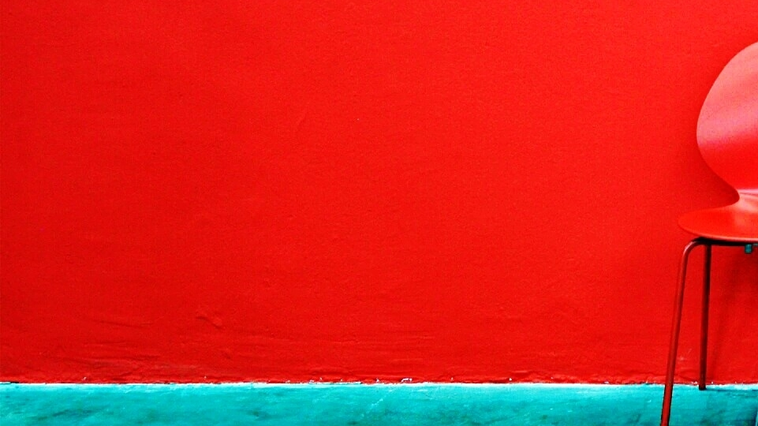
Board of directors
Mr. Asif Qadir
Mr. Abrar Hasan
Mr. Akbarali Pesnani
Mr. Azam Faruque
Independent Directors
Independent Directors
Non-Executive Directors
Executive Directors
Mrs. Zeeba Ansar
Mr. Omar Faruquee
Mr. Arif Faruque
Mr. Yasir Masood
Independent Directors
Non-Executive Directors
Non-Executive Directors
Executive Directors

Slide 7
1. Audit Committee 2. Human Resource & Remuneration Committee
Types of Committees

Slide 8
The global economy, including Pakistan's, is being impacted by soaring commodity prices, particularly oil and coal. During the nine-month review period, cement demand fell by 6%, with exports declining by 35%. This was due to low export prices, high ocean freight costs, and challenges in exporting to Afghanistan because of the unstable political and economic situation and border clearance issues.
Summary of Directors Report:

Slide 9
Number and Types of shares
Types of Shares | Total shares
Ordinary shares | 194,295,038

Slide 10
Name of Audit Firm
EY ford Rhodes
Chartered Accountants

Slide 11

FINANCIAL ANALYSIS

Slide 12
CHERAT CEMENT COMPANY LTD BALANCE SHEET AS OF ANNUAL 30 JUNE 2022
ASSETS | (Rupees in Million)
Non-current assets | 28,140
Current assets | 10,465
Total Assets | 38,605
Liabilities
Non current | 11,442
current | 9,847
Total Labilities | 21,289
Equity
Shareholders' Equity | 17,316
Total Equity | 17,316

Slide 13
CHERAT CEMENT COMPANY LTD Income statement ANNUAL 30TH JUNE 2022
Entities | Amount(in millions)
Turnover - net | 32,085,361
Cost of sales | (23,134,576)
Gross profit | 8,950,785
Distribution costs | (529,254)
Administrative expenses | (349,141)
Other expenses | (275,286)
Total expenses | (1,153,681)
Other income | 390,495
Operating profit | 8,187,599
Finance costs | (1,358,874)
Profit before taxation | 6,828,725
Total taxation | (2,372,760)
Net profit | 4,455,965
Earnings per share (basic and diluted) | 22.93

Slide 14
Calculated Ratios

Slide 15
Ratios | Calculations | Answers
Solvency Ratios Equity Multiplier Leverage Ratio Interest Coverage Ratio Liquidity Ratios Quick Ratio Current Ratio Cash Ratio Probability Ratios Gross Profit Margin SG&A Margin Net Profit Margin ROA ROE Efficiency Ratios Inventory Turnover Accounts Receivable Turnover Asset Turnover Accounts Payable Turnover Working Capital Turnover | Avg Total Assets / Total Equity Average Total Liability/Avg Shareholder EBIT/Interest Expense Cash And Market Sec + Acc Reciev/Current Liability Current Assets/Current Liabilities Gross Profit/Sales Sg&a Expenses/Sales Net Income/Sales Net Income/Assets Net Income/Equity Cogs/Avg Inventory Sales /Avg Accounts Receivable Net Sales / Averazge Total Assets Net Credit Purchases / Avg Acc Pay Net Sales / Average Working Capital | 2.18 1.18 1.01 0.43 1.17 0.03 0.1452 0.0592 0.0263 0.0399 0.0871 3.16 5.31 0.36 0.11 0.08

Slide 16
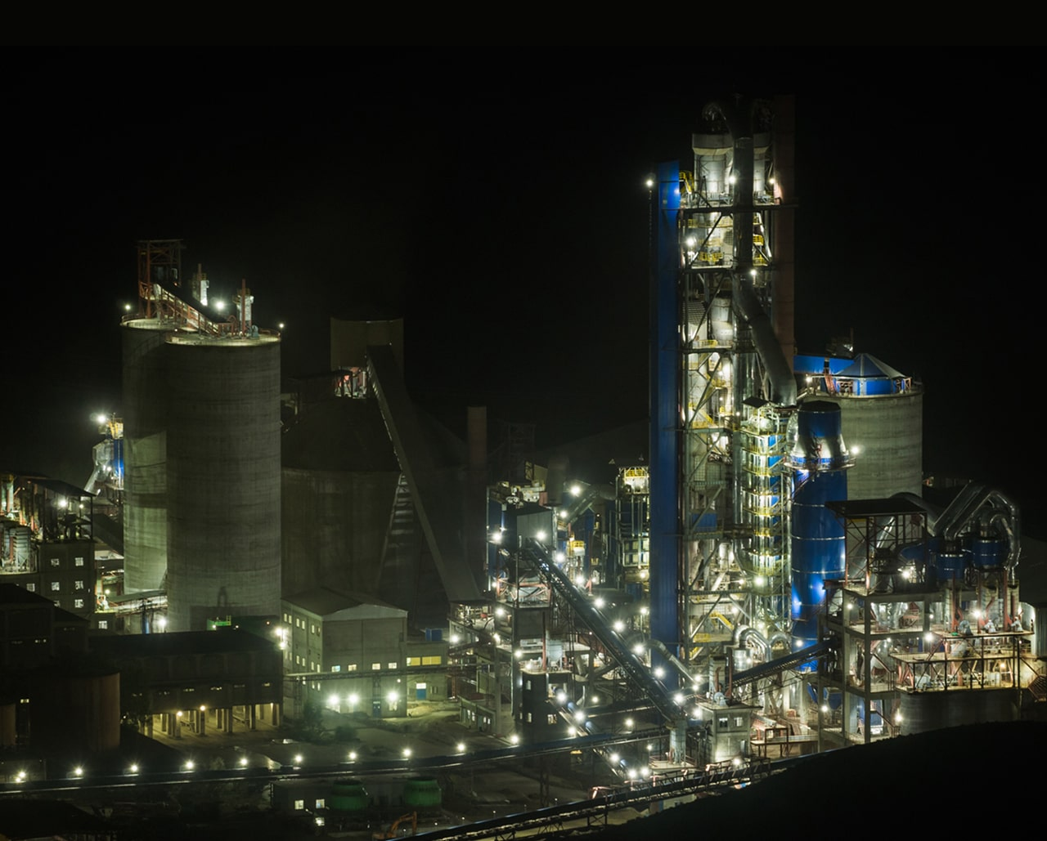
SUMMARY
Cherat Cement co. ltd. Strives for the growth of company through the best value creation for the benefit of all stakeholders and achieve excellence in business. Along with that the company invests in projects that will optimize the return and reduce the risk profile of the Company.

Slide 17

THANK YOU

